Slide 1
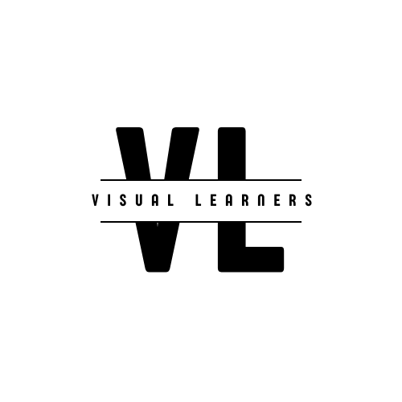

YOLO SERIES
PART ONE
INTRODUCTION TO YOLO
Presented by TEDDY TASSEW

Slide 2
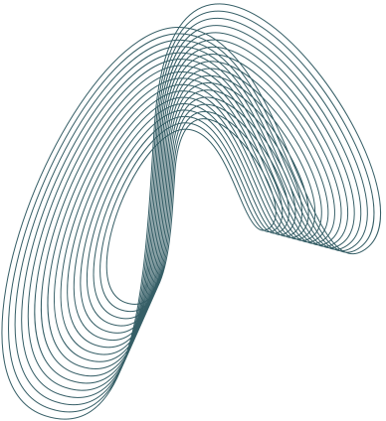
Agenda
01
INTRODUCTION TO YOLO
What's in store for today
02
WHY YOLO IS USEFUL?

Slide 3
Agenda
03
HISTORY AND MILESTONES
What's in store for today
04
APPLICATIONS

Slide 4
Agenda
05
OTHER OBJECT DETECTORS
What's in store for today
06
KEY INSIGHTS

Slide 5


WHAT IS YOLO?
DEFINITION
Standing for You Only Look Once, YOLO is a regression algorithm that falls under the class of real-time object detection methods with a multitude of computer vision applications.

Slide 6
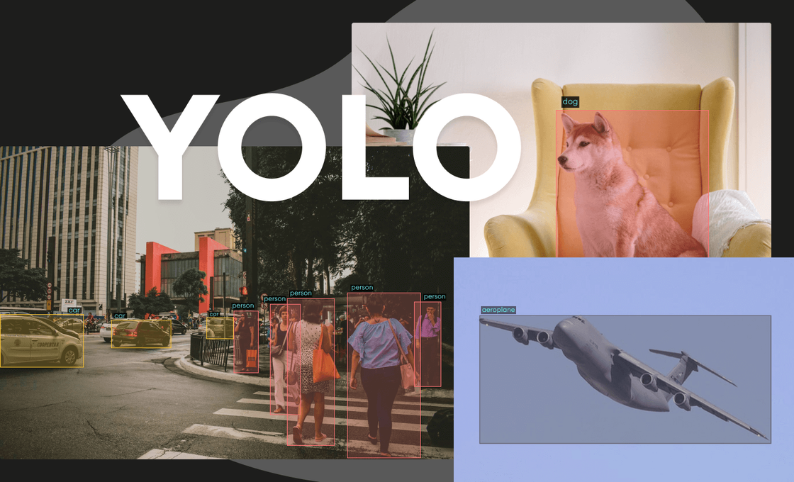
YOLO combines what was once a multi-step process, using a single neural network to perform both classification and prediction of bounding boxes for detected objects.
As such, it is heavily optimized for detection performance and can run much faster than running two separate neural networks to detect and classify objects separately.

Slide 7
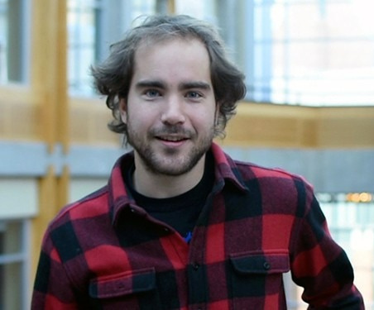
Creators
Joseph Redmon, creator of the popular object detection algorithm YOLO (You Only Look Once), maintains the Darknet Neural Network Framework and the corresponding author of the papers YOLOv1, YOLO9000: Better, Faster, Stronger and YOLOv3: An Incremental Improvement.

Slide 8

However, in Feb 21, 2020 Joseph Redmon tweeted that he had ceased his computer vision research to avoid enabling potential misuse of the tech — citing in particular “military applications and privacy concerns.”

Slide 9
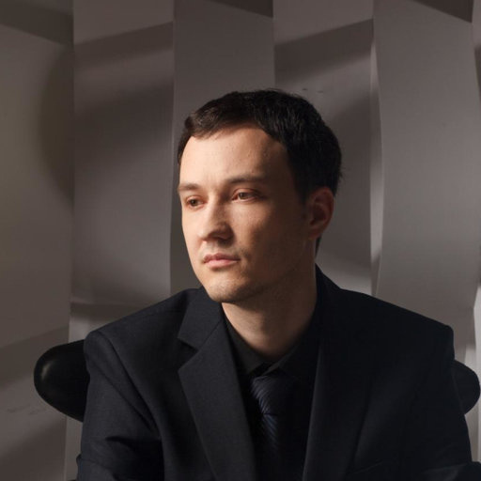
Alexey is a research engineer with six years of experience in machine learning and over sixteen years of experience as a C++ developer.
He specializes in PyTorch, C++ and DNN‐framework Darknet as well as developing a state‐of‐the‐art neural network for computer vision such as YOLOv4 / Scaled‐YOLOv4, which is used by the Taiwan government, BMW Innovation Lab, Amazon, and other companies.

Slide 10
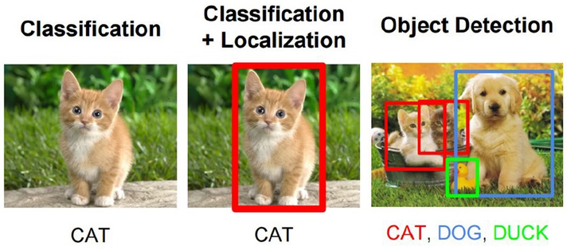

Classification
Given an image with one object, we tell what kind of object it is. This is the case of classification.
Localization
Next comes localization, where we not only tell what kind of object it is, but we also locate it in the image. Programmatically speaking, we have to draw the correct bounding box around it.
Object Detection
If there are more than one objects in the image, we have to locate and identify all of them. This task is Object Detection

Slide 11
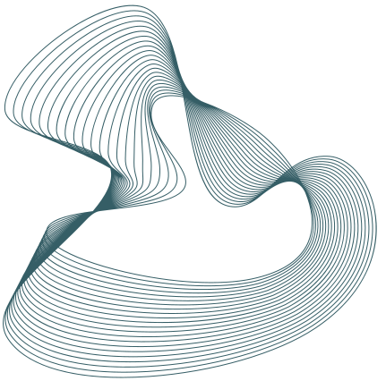
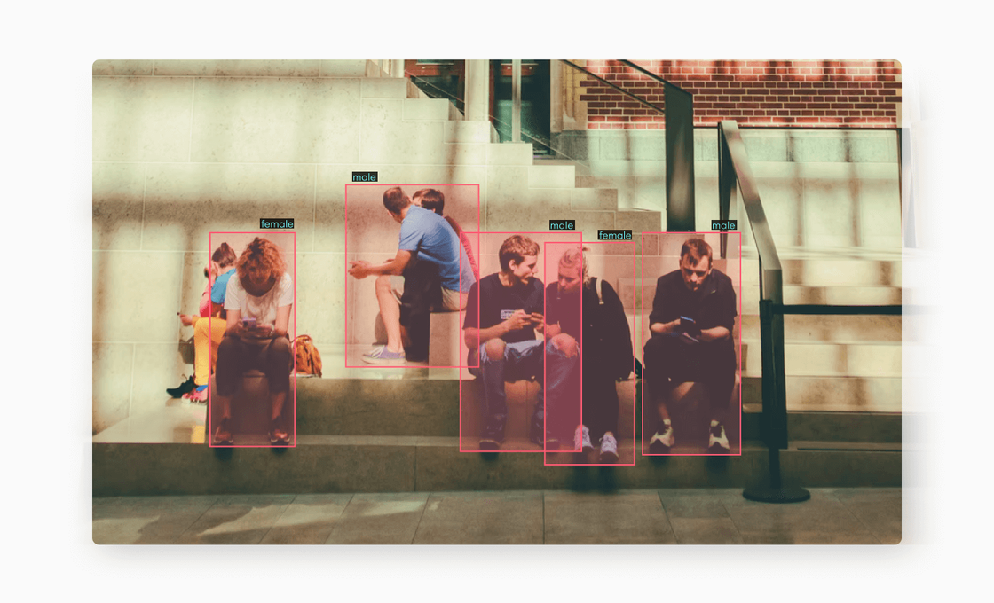
Why YOLO is useful?
First, it improves the detection time given that it predicts objects in real-time.
Second, YOLO provides accurate results with minimal background errors.
And finally, the algorithm has wonderful learning capabilities that enable it to learn the representations of objects and implement them in object detection tasks.

Slide 12
YOLO Timeline
2016
2017
2018
April, 2020
June, 2020
Release of YOLOv1
Release of YOLOv2
Release of YOLOv3
Release of YOLOv4
Release of YOLOv5
The first paper not authored by Joseph Redmon. Alexey Bochkovski introduced novel improvements, including min activation, improved feature aggregation.
Glenn Jocher continued to make further improvements in his June 2020 release, focusing on the architecture itself.
Fully convolutional network for object detection
This version earned an honorable mention at CVPR 2017 because of significant improvements on anchor boxes and higher resolution.
It provided an improved performance on tiny objects because of the ability to run predictions at three different levels of granularity.

Slide 13

PP-YOLO
Jul 23, 2020 stands for PaddlePaddle – You only look once.
Scaled YOLOv4
Nov 16, 2020 Scaling Cross Stage Partial Network
YOLOR
Recent Releases
May 10, 2021 You Only Learn One Representation
YOLOX
Jul 18, 2021 An anchor-free version of YOLO
YOLOv7
Jul 06, 2022 Surpasses all known object detectors in both speed and accuracy

Slide 14
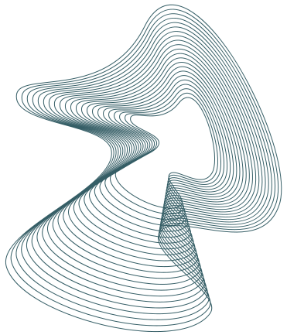
APPLICATIONS OF YOLO
Autonomous driving: here object detection is required to avoid accidents on the road since there is no human managing the wheel. In this case, YOLO helps detect people, cars, or any external hazards appearing on the road.
Wildlife detection: this is as applicable for trees and biodiversity as it is for different species of animals to track their growth and migration.
Robotics: depending on the industry the robot operates in, some robots do require computer vision to detect objects on their path and perform a particular instruction.
Retail: visual product search or reverse image search are becoming increasingly popular in retail, which wouldn’t have been possible without object detection algorithms like YOLO.

Slide 15
OTHER OBJECT DETECTORS
Histogram of Oriented Gradients (HOG): is one of the traditional object detection methods, first introduced in 1986. Current HOG uses a feature descriptor to detect objects of interest. While revolutionary in the beginning, this method is time-consuming for complex computer vision tasks.
Fast R-CNN: is an improved version of the initial R-CNN, where most of the upgrades concern speed. Advantages include higher detection quality, as compared to R-CNN, single-stage training using a multi-task loss, no disk storage for feature caching, and more.
Faster R-CNN: is one of the most robust version of the R-CNN family. The Faster R-CNN method takes the selective search algorithm adopted by R-CNN and Fast R-CNN to the next level by using the superior region proposal network. This means that the algorithm computes the image with a wider range to generate more accurate results.

Slide 16
OTHER OBJECT DETECTORS
SSD: The Single Shot Detector or SSD is one of the fastest real-time object detection models. It can achieve an astonishing five to tenfold increase in speed, compared to RCNNs, by taking advantage of multi-scale features and default boxes.
RetinaNet: Introduced in 2017, Retinanet became one of YOLO’s main competitors as a single-run object detection model. Indeed, when RetinaNet was first released, its architecture amazingly surpassed YOLOv2, and also challenged R-CNN’s accuracy. These characteristics made the model widely applicable in satellite and aerial imagery, in particular.

Slide 17
CONCLUSION
The ongoing innovation will continue to generate more demand for computer vision models, where YOLO will still hold its special place for a number of reasons: YOLO heavily relies on a unified detection mechanism that consolidates different object detection elements into a single neural network to effectively perform computer vision tasks. Thanks to YOLO, the models can be trained with a single neural network into an entire detection pipeline. It’s not surprising that the algorithm found application in countless industries, eventually becoming the nexus for projects invested in object detection.

